Slide 1
NYC Taxi Data Analysis
July 2018
https://en.wikipedia.org/wiki/File:USACab.JPG

Slide 2
Environment
MacBook Pro
OSX 10.11
Anaconda Python 3.6.5
Need to “pip install plotly”
Analysis using Jupyter Notebook
Also uses Plotting.py and qagDate.py utilities

Slide 3
Steps performed
Load data and play with it.
taxi input data v2c.pynb
taxi input fare v6.pynb
Confirm rows in Data and Fare files are in same order.
Check link keys v1.pynb
Merge Data and Fare files and save as hdf (h5). Use this thereafter.
Merge Fare and Data v1.pynb
Generates: data_taxi_merged.h5
Work through the questions.
Enhance the data (add features) when required.
Generate results.
Make powerpoint summary

Slide 4
Background
NYC Taxi & Limousine Commission shared about 1.1 billion taxi trips.
This covered the period from January 2009 to June 2015.
The data was released to Chris Wong after he made a request under state Freedom Of Information Law (FOIL).
Around 50Gb of data was released onto hard drives provided by Chris Wong.
Various forms of this were then uploaded onto the internet.
The Medallion (taxi identifier) and Hack License (driver identifier) were anonimised using MD5 hashes.
This was soon de-anonimised due to the known structure of the Medallion and Hack License identifiers.
There are around 13,000 taxis and 33,000 drivers. These numbers are reducing due to competition from companies like Uber.
The data provided for this analysis is for the month of April 2013. There are roughly 15 million taxi trips included.

Slide 5
Basic questions
See file:
Questions a) to i): taxi input fare v6.pynb

Slide 6
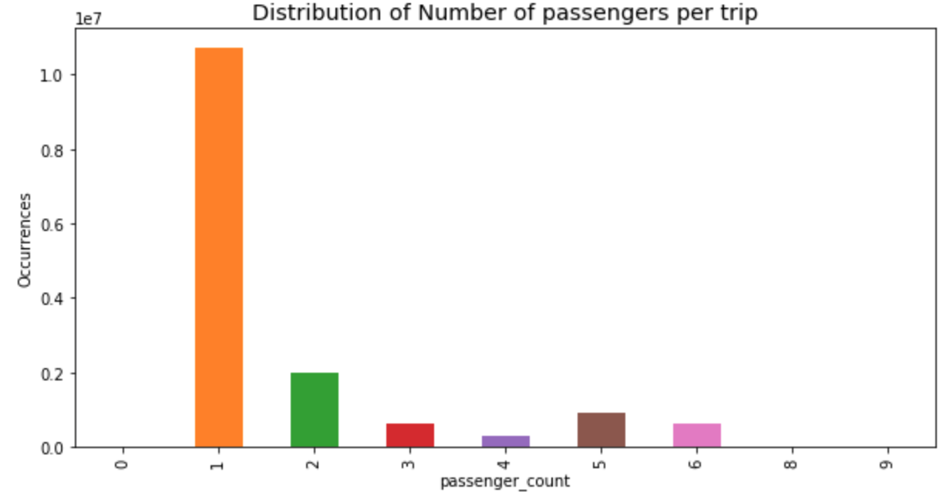
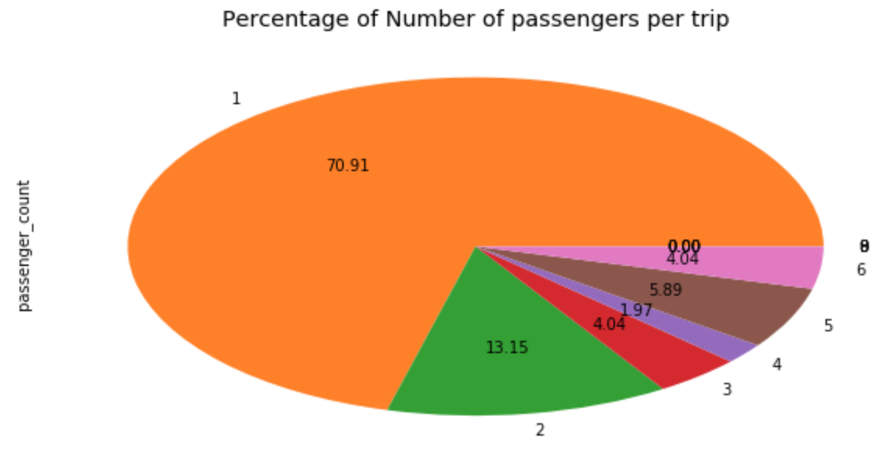
BQ a) Distribution of number of passengers per trip
Total of roughly 15 million trips
Roughly 11 million single passenger trips (71%)
Roughly 2 million dual passenger trips (13%)
Single anomalous 8 and 9 passenger trip

Slide 7
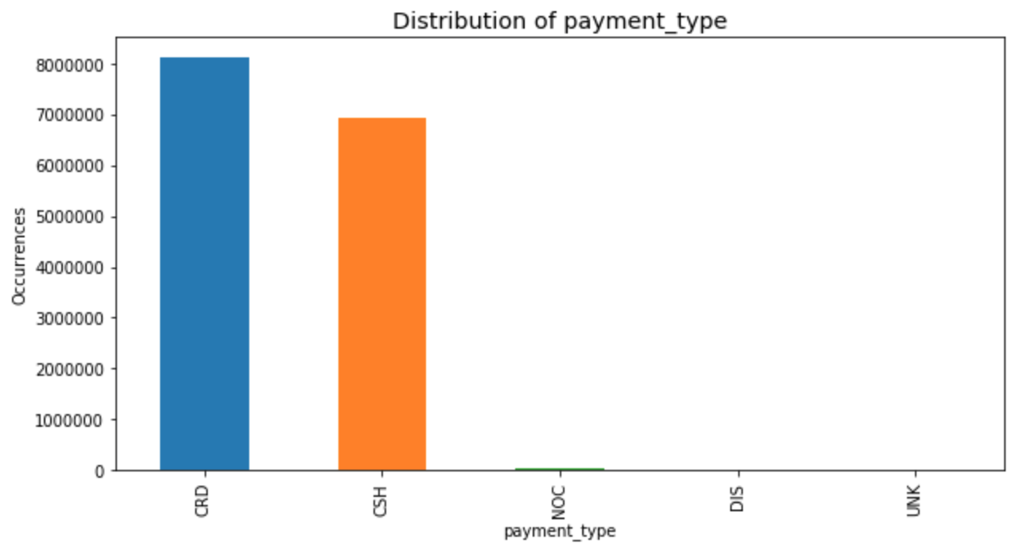
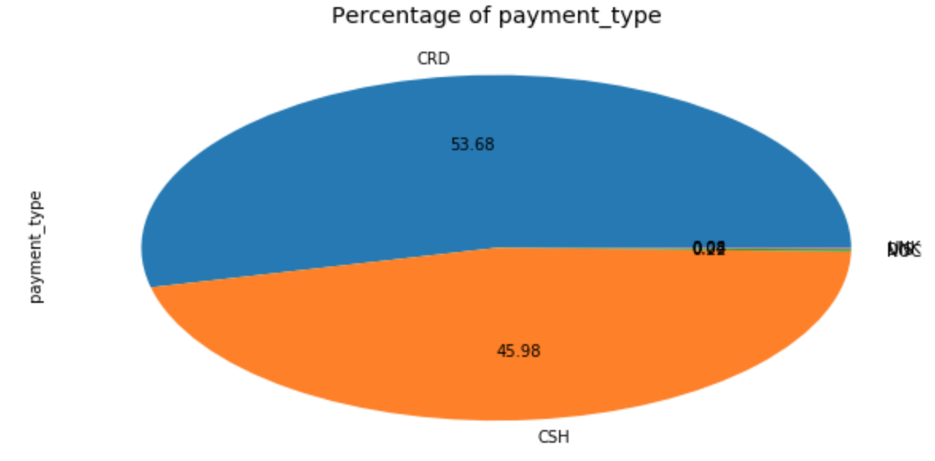
BQ b) Distribution of payment type per trip
Total of roughly 15 million trips
These are split roughly evenly between Credit (54%) and Cash (46%).

Slide 8
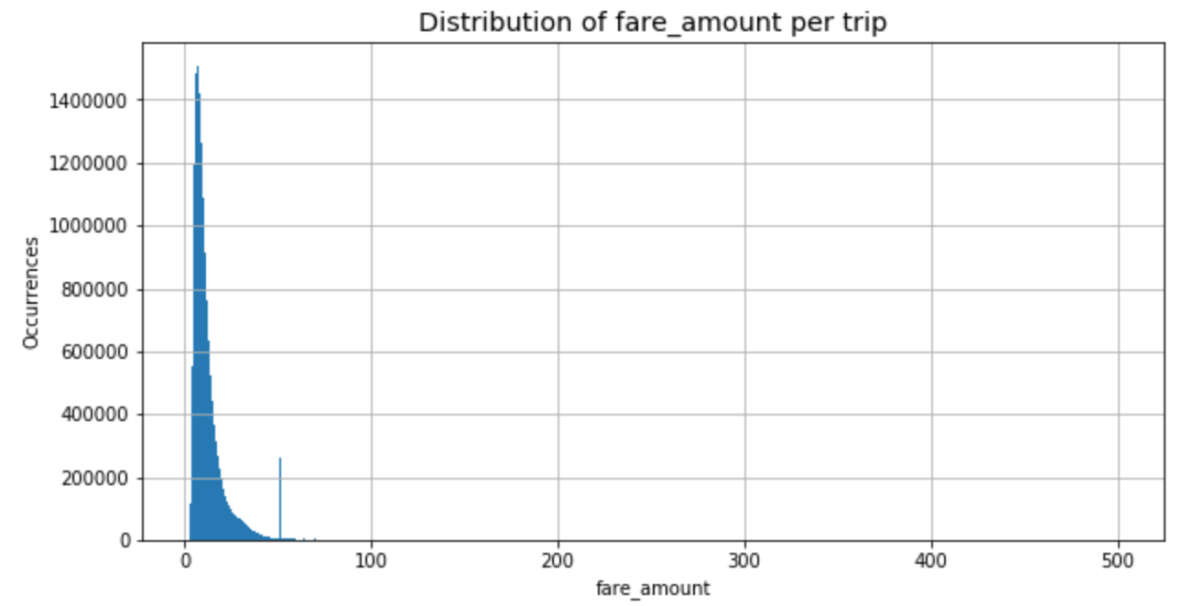
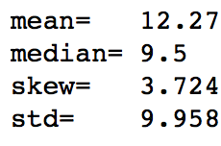
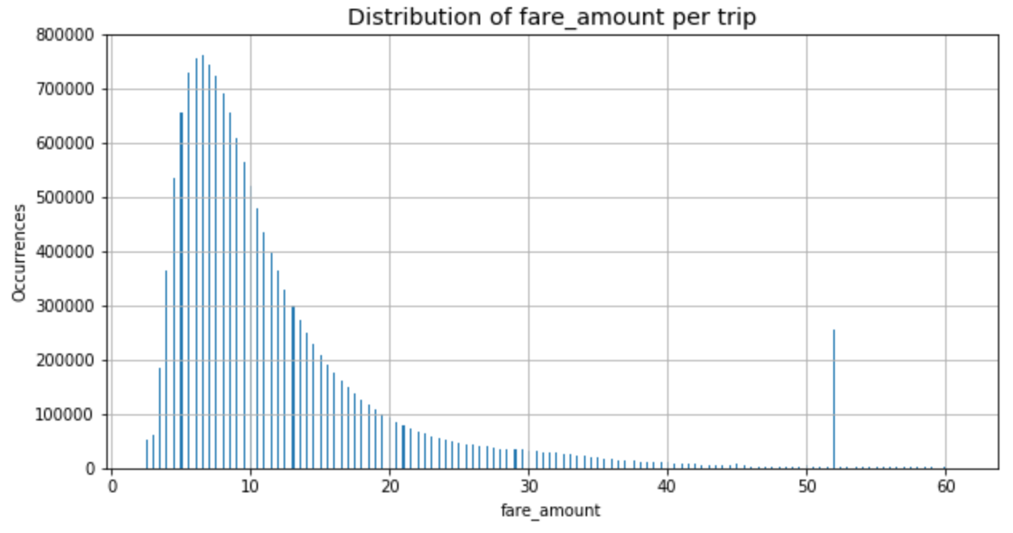
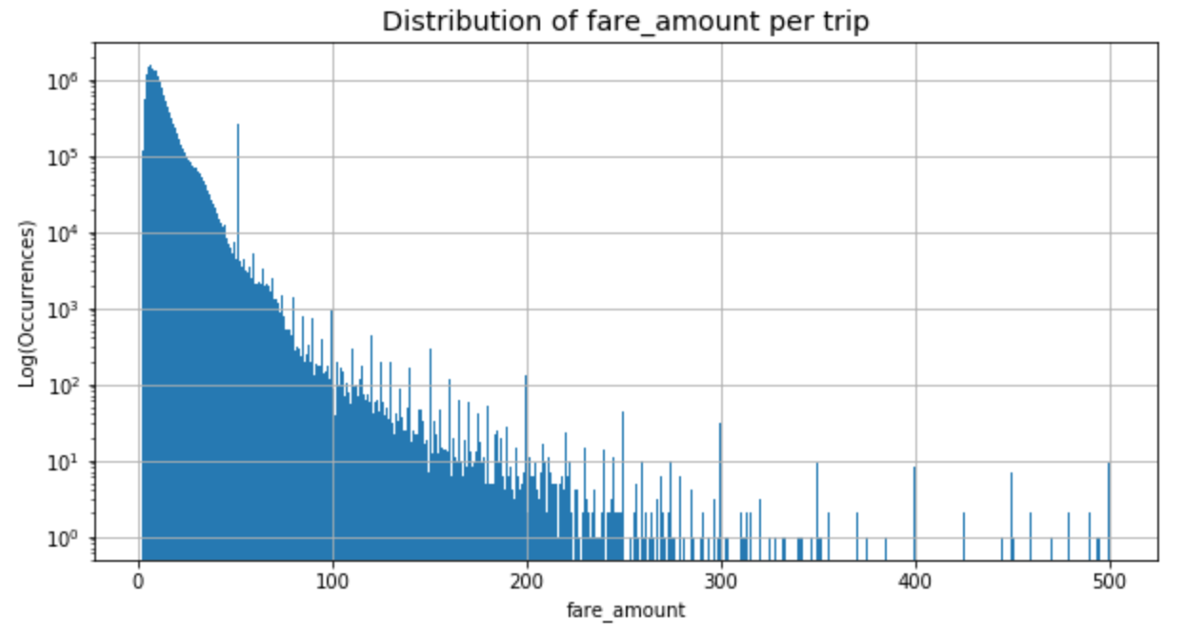
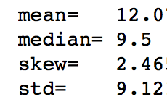
BQ c) Distribution of fare amount
Total of roughly 15 million trips
Distribution skewed with long tail to the right (high fares)
See spikes for multiples of $50
Also spike for $52 which is the fixed rate between JFK and Manhattan.

Slide 9
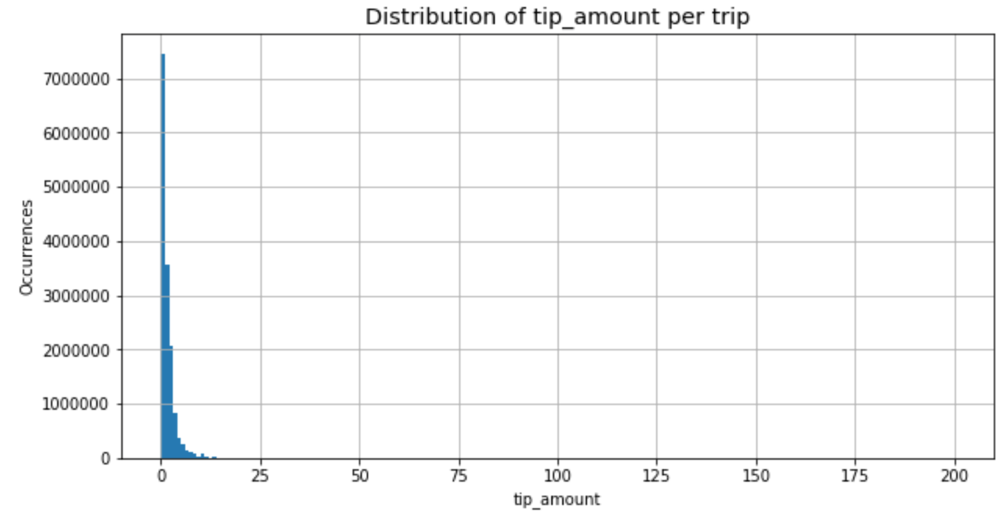
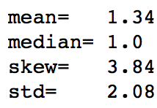
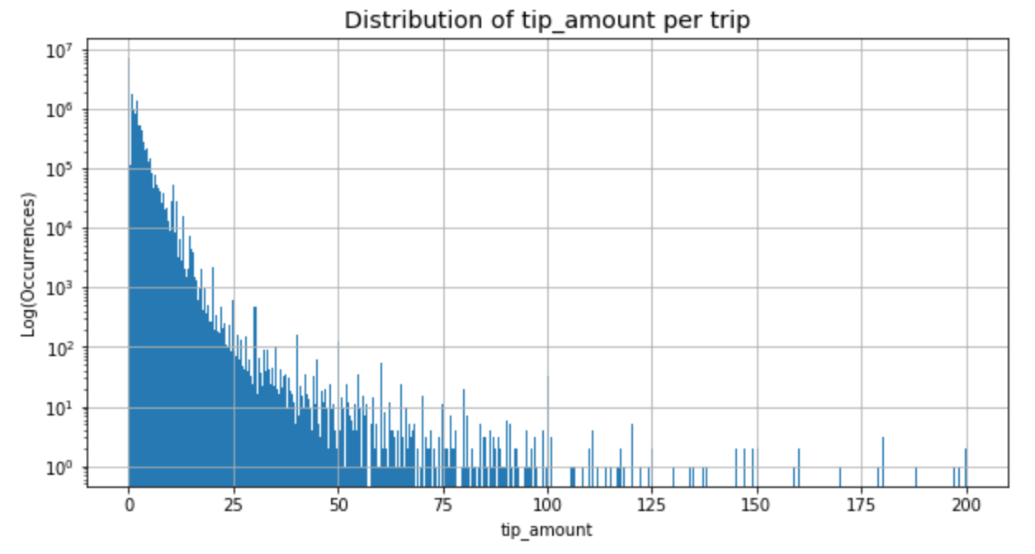
BQ d) Distribution of tip amount
Total of roughly 15 million trips
Distribution skewed with long tail to the right (high tips)
See spikes for multiples of $50
Also spikes for multiples of $20

Slide 10
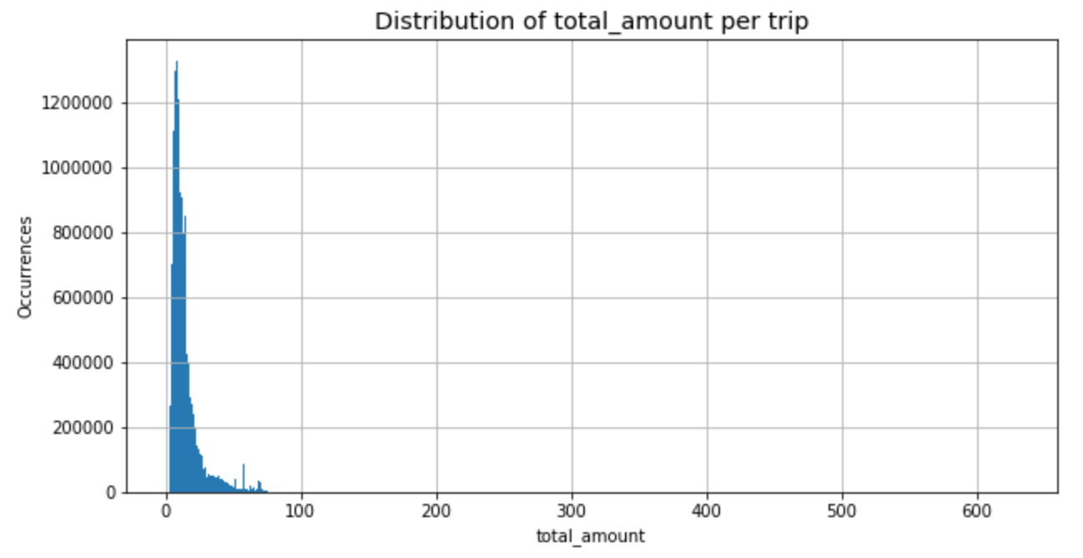
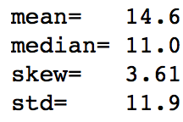
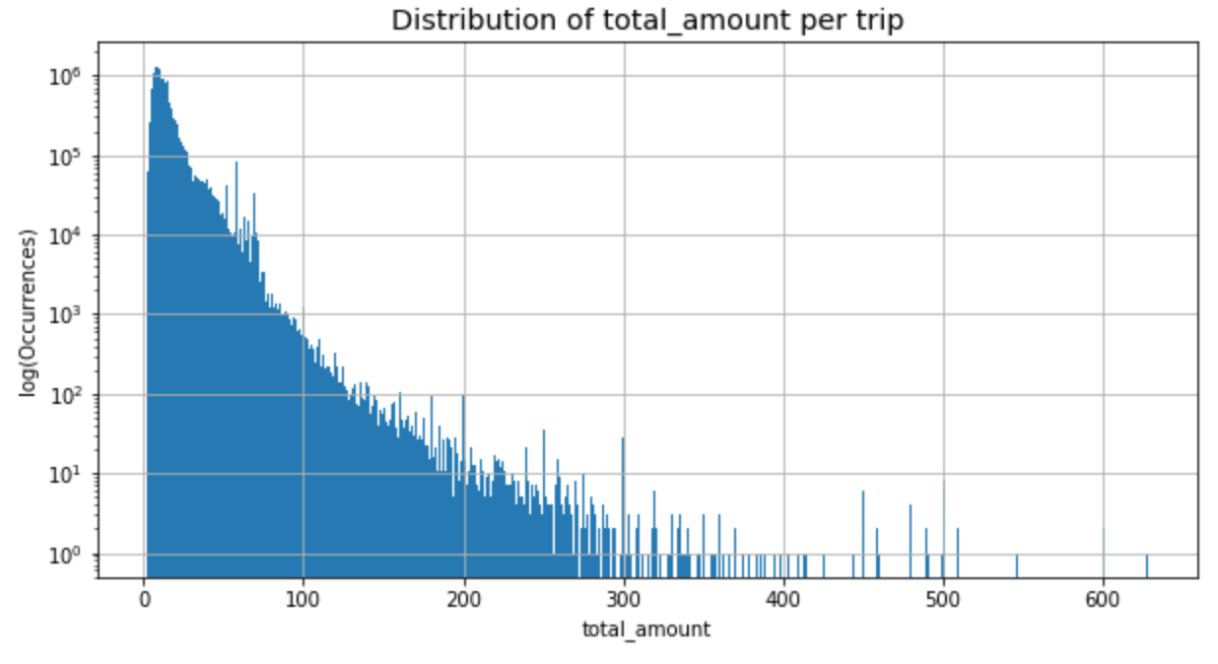
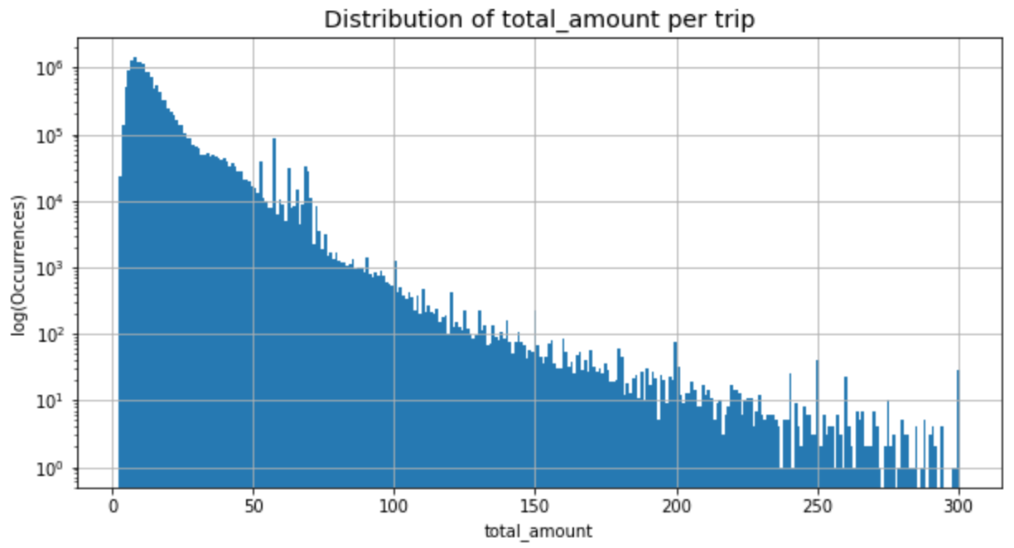
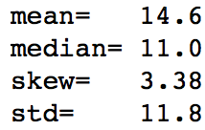
BQ e) Distribution of total amount
Total of roughly 15 million trips
Distribution skewed with long tail to the right (high total amount)

Slide 11
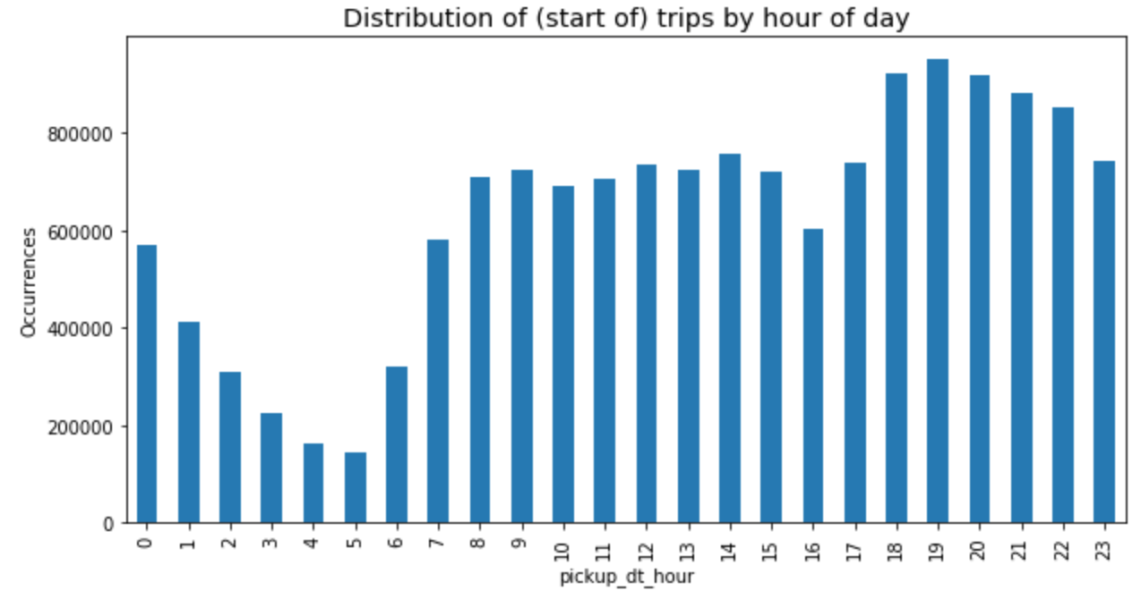
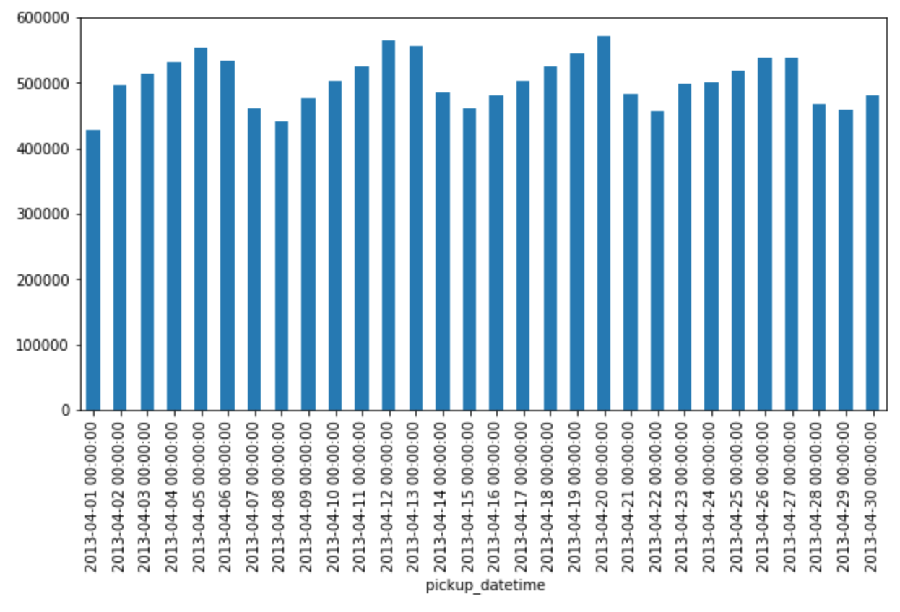
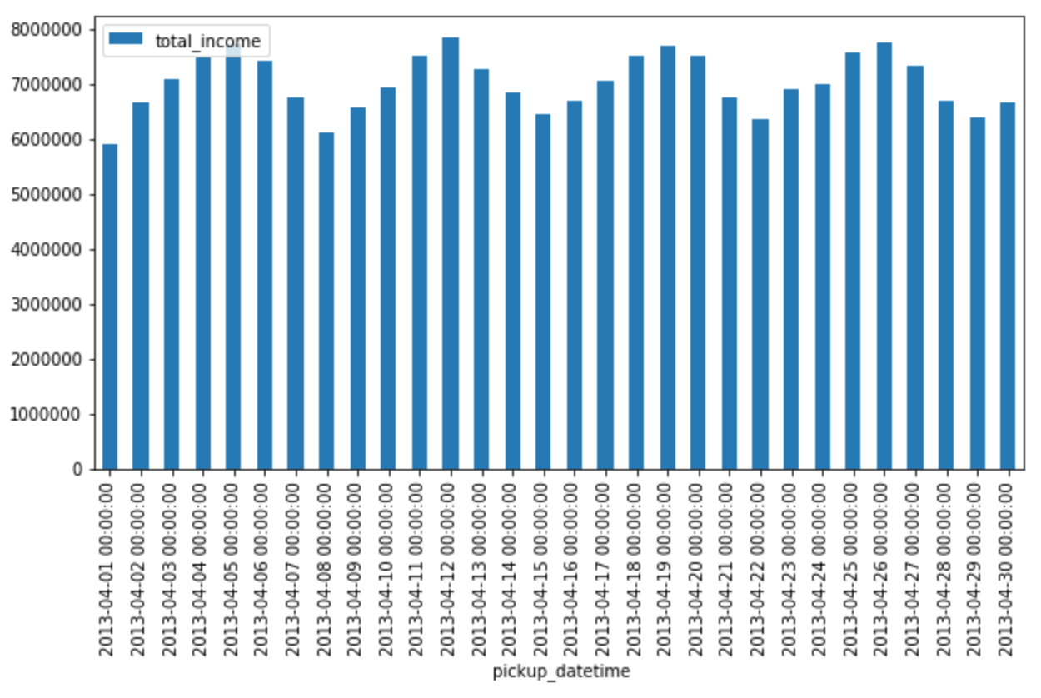
BQ f) Top 5 busiest hours of day
Looked at ‘trips per hour’ and ‘income per hour’ as measures of busy.
Five busiest hours are from 18:00 to 23:00.
But no doubt there is day dependent structure. See next slide.
Also see structure in total trips per day (of the month) and total income per day.
Weekly cycle (low on Mon and increases till Sat, then starts reducing)
Total trips per day Total income per day

Slide 12
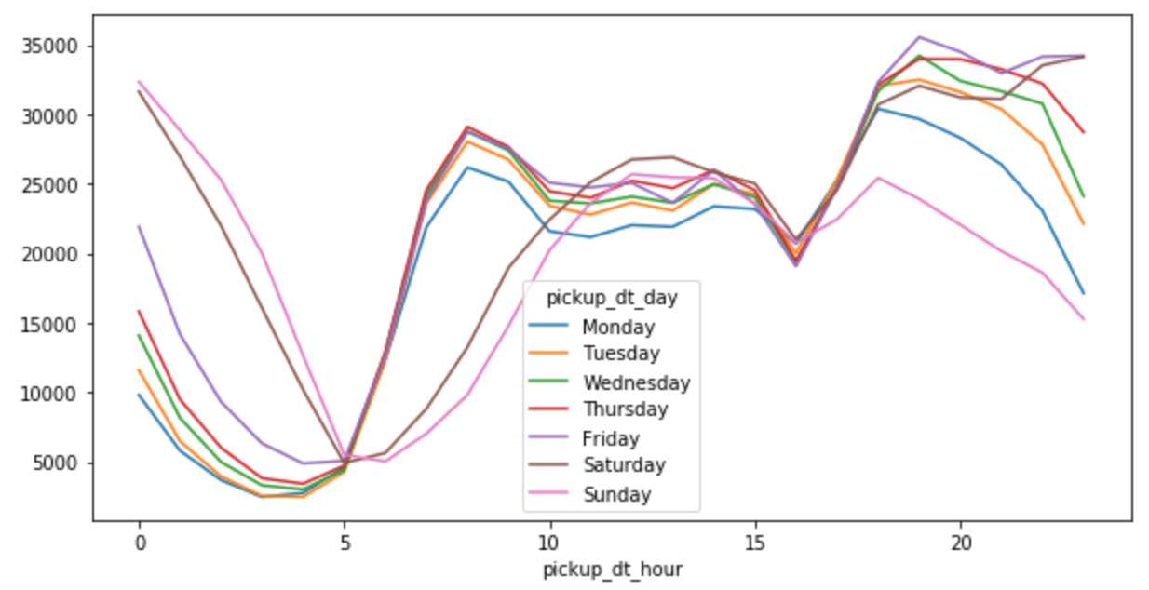
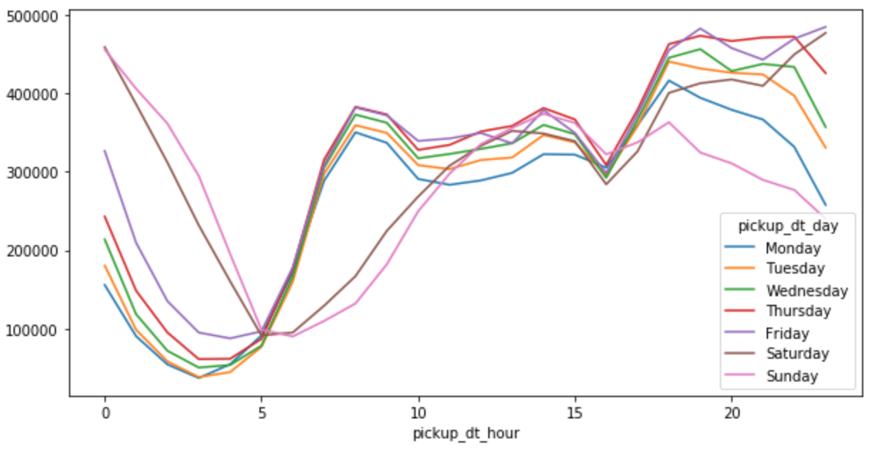
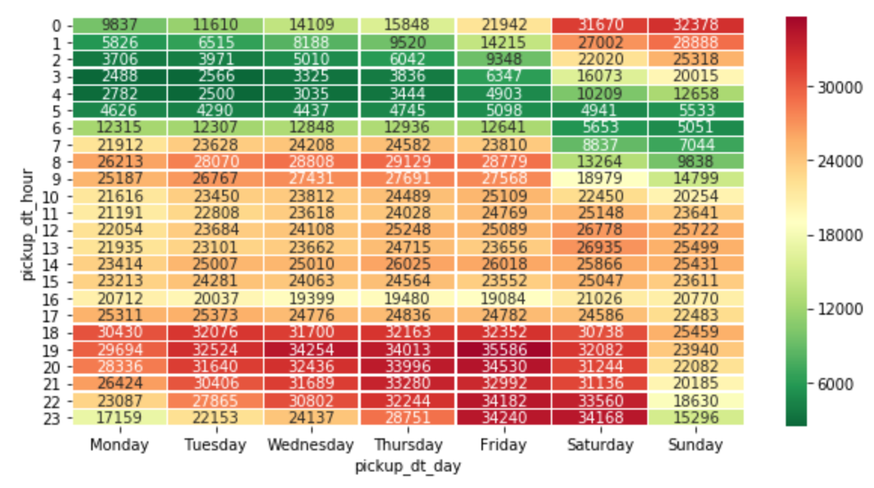
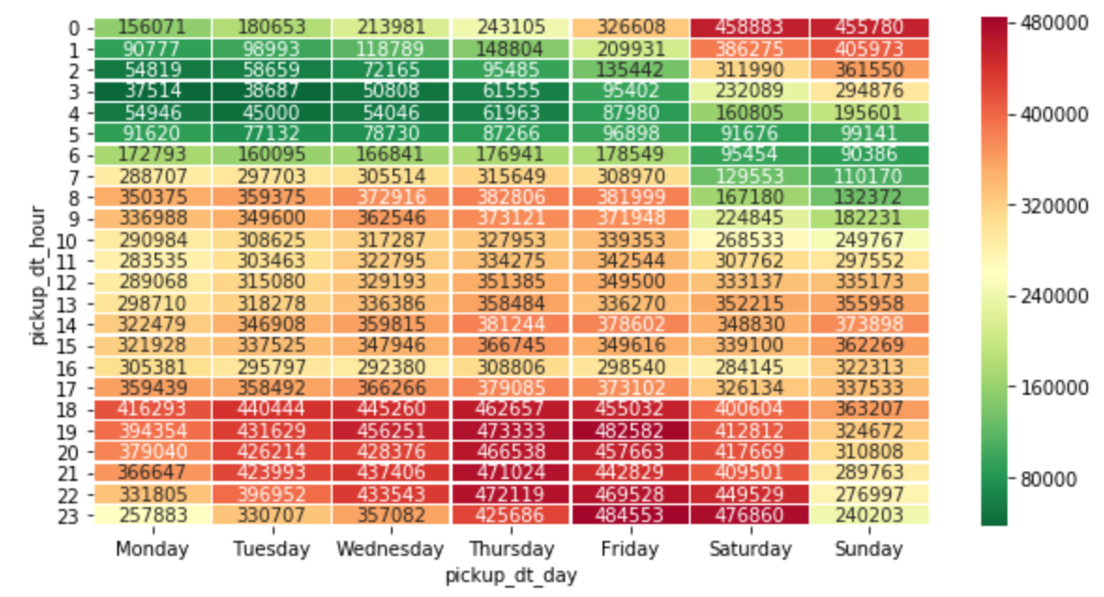
BQ f) Top 5 busiest hours of day
‘trips per hour’ ‘income per hour’
The two measures are consistent.
Remember how the lines join (23:59 on a day moves to 0:00 on the next day).
Weekdays:
High 18:00 to 23:00
Times shift later as week progresses
Busy 08:00 to 10:00 rush hour
Low from 1:00 to 6:00
Weekend:
Fri and Sat nights 00:00 to 03:00 busy with partying
10:00 to 1600 generally busy
Shift changeovers at 05:00 and 16:00.
Lines for Sat and Sun clearly different to the weekdays

Slide 13
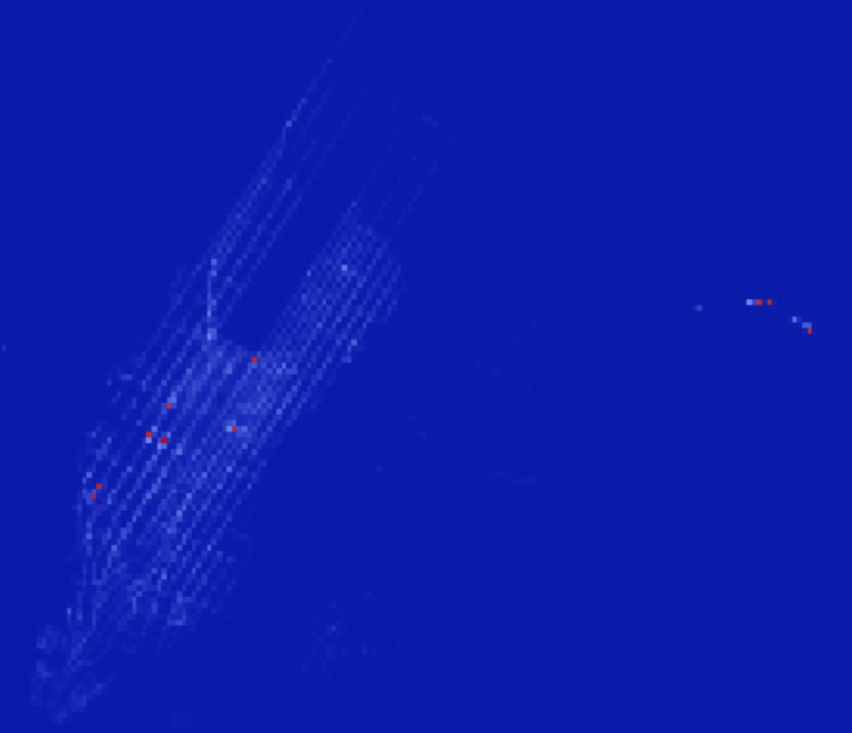
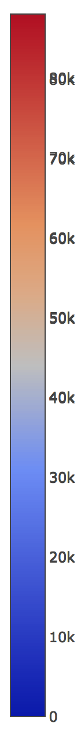
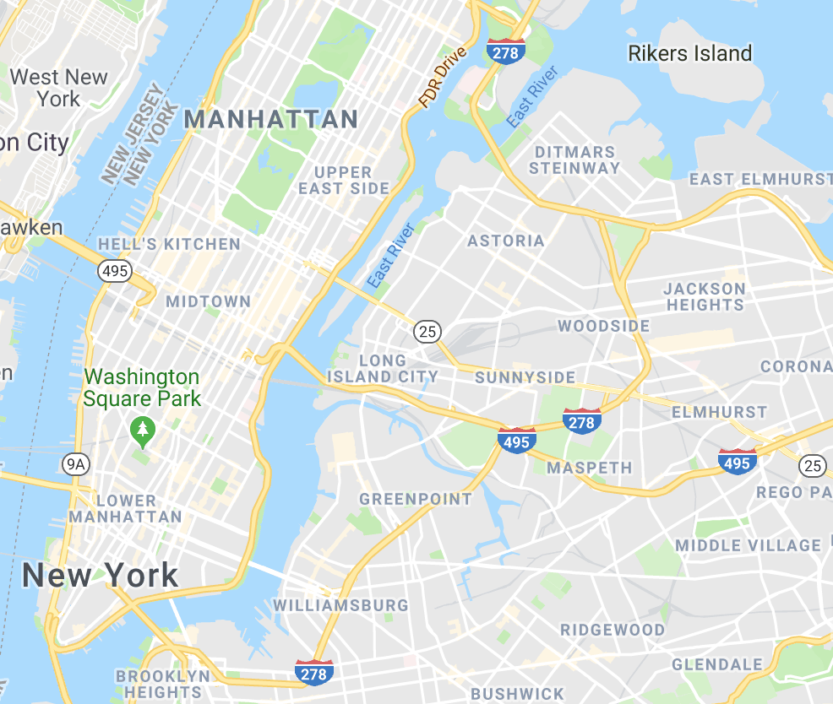
BQ g) Top 10 busy locations
88214.0 -73.9920 40.7497
61200.0 -73.9950 40.7509
55889.0 -73.8635 40.7684
52705.0 -73.8715 40.7734
49319.0 -73.9910 40.7556
46684.0 -73.875 40.7734
31765.0 -74.0059 40.7398
31526.0 -73.9741 40.7635
30375.0 -73.9780 40.7517
29870.0 -74.0049 40.7418
4 3 6
5
8
2 1
9
7
10
11 (off the image)

Slide 14
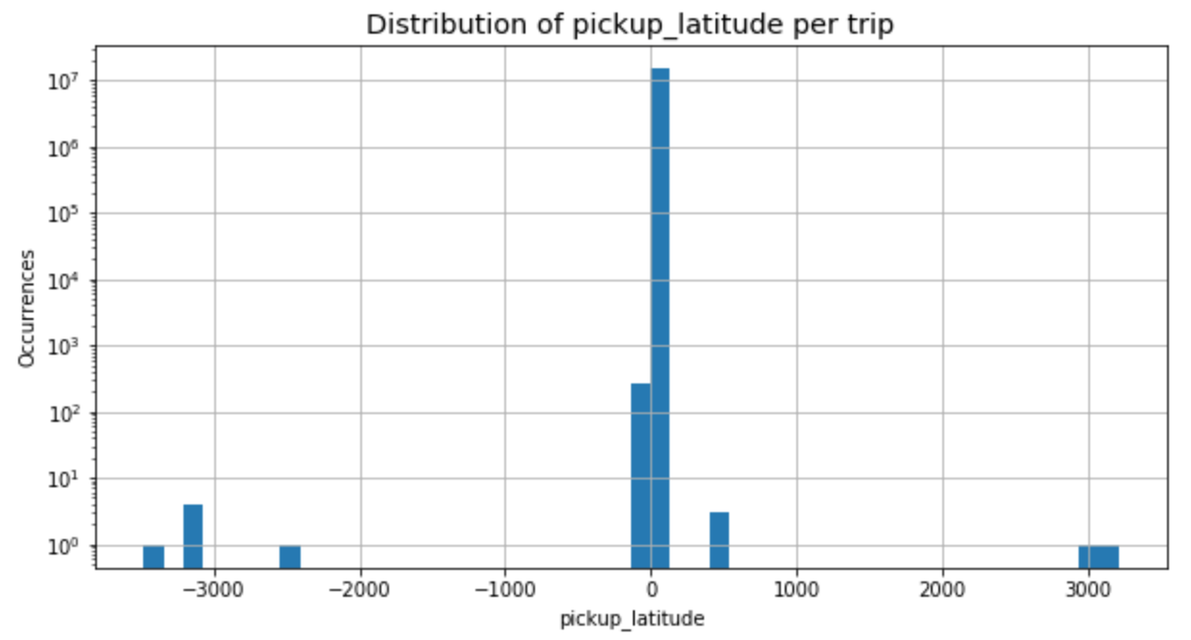
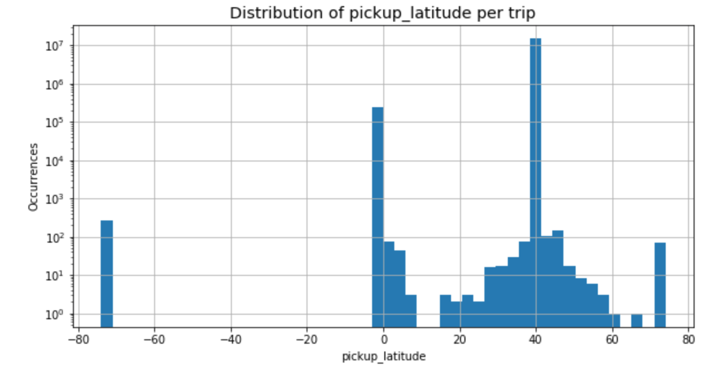
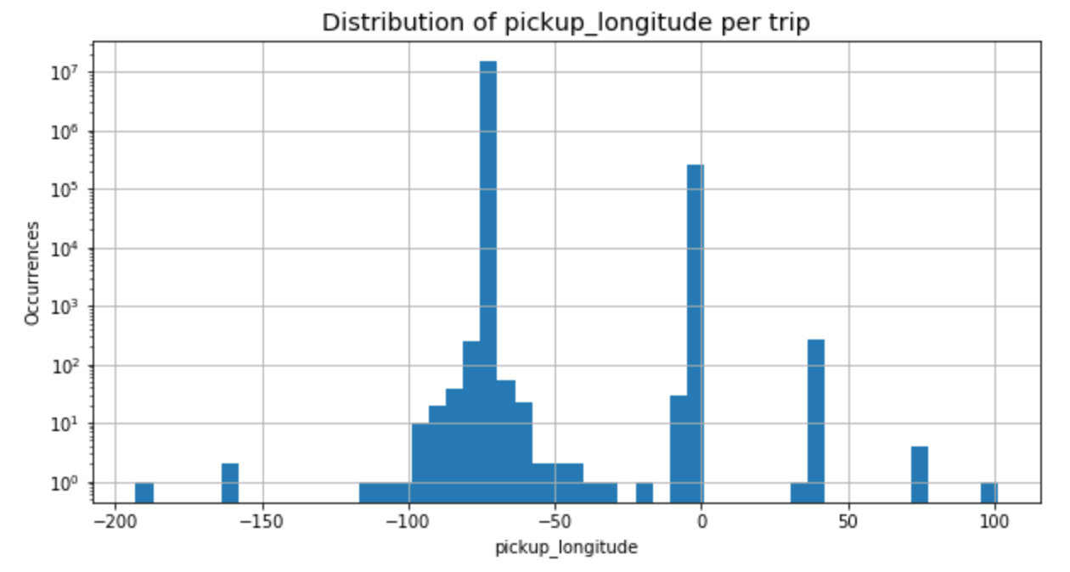
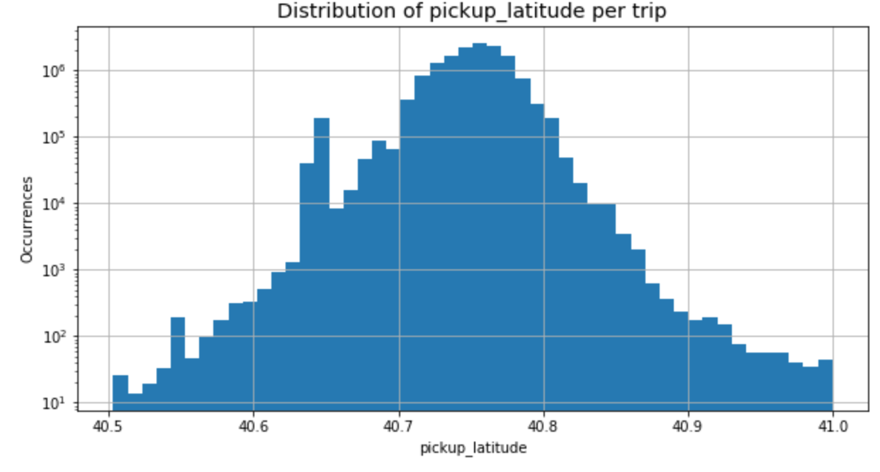
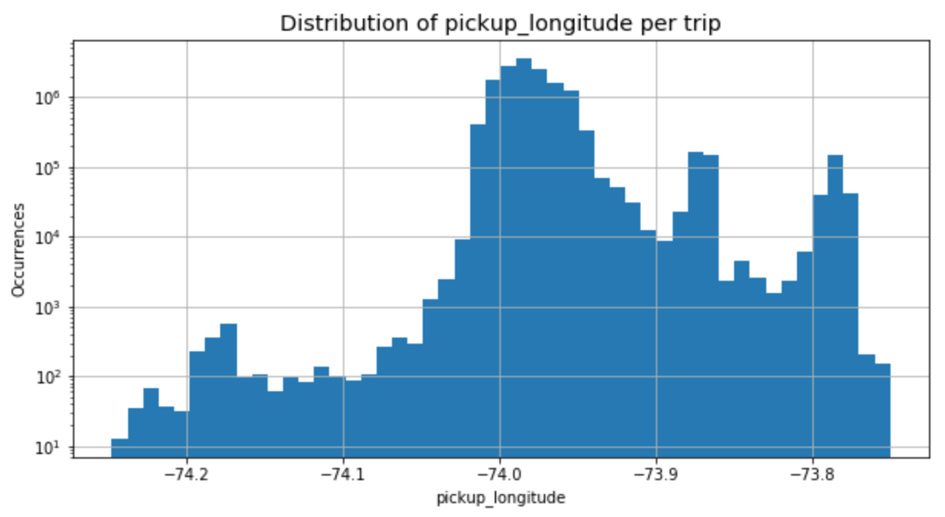
BQ g) Top 10 busy locations
Examining distribution of pickup coordinates shows that there are outliers.
Expecting latitude around 40 and longitude around -70.
Can see some spikes where latitude and longitude have been reversed when entered.
Also spikes at 0, where coordinates not used.
Decision to remove them all and focus on Manhattan area coordinates.
GPS coordinates in decimal degrees, so 0.001 roughly 100m and 1.0 roughly 100km.
Used latitude between 40.5 and 41.0 (distance of roughly 50km).
Creating a grid with 500 buckets gives resolution of roughly 100m per bucket.
Used longitude between -74.25 and -73.75.(again roughly 50km, so get square grid).
See spikes:
La Guardia: 40.77, -73.86
JFK: 40.65, -73.78

Slide 15
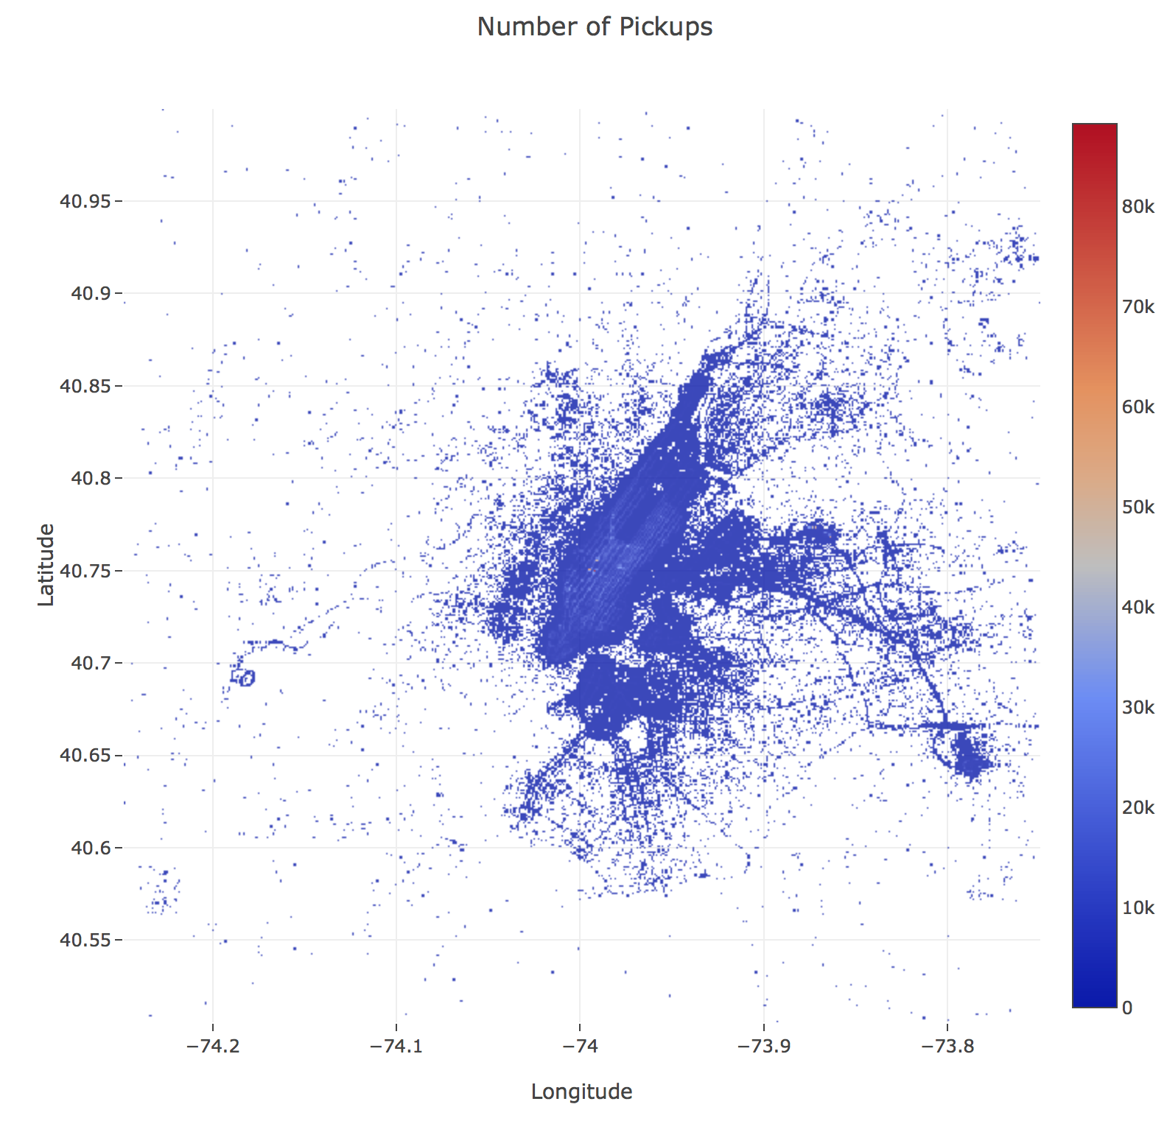
BQ g) Top 10 busy locations
Another plot showing pickup locations.
See nice structure of NYC area.
Obviously the choice of gridsize at roughly 100m x 100m impacts the selection of busy locations.
For example, numerous cells at La Guardia, Pennylvania station, JFK, etc.
If pickups at a location are spread out over a few cells, then this can knock them out of the top 10 list.
Could have a multi-tiered selection process using coarse grids and then zooming in.

Slide 16
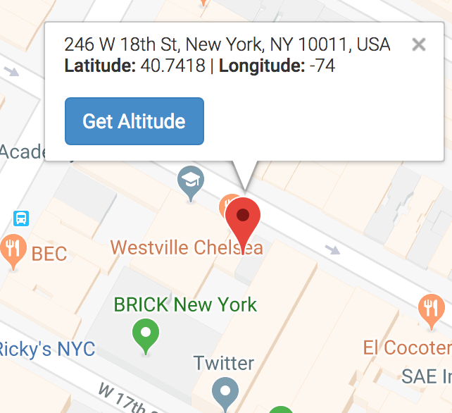
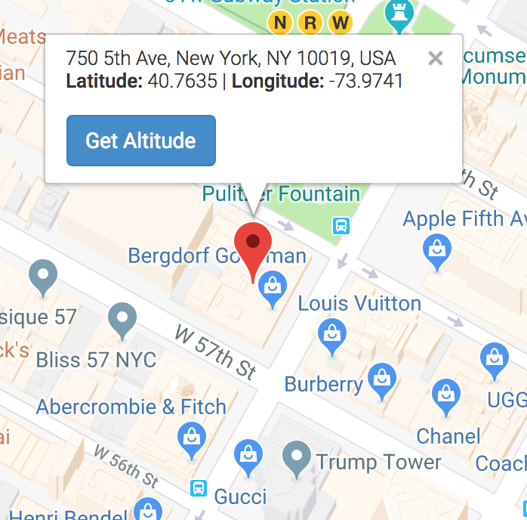
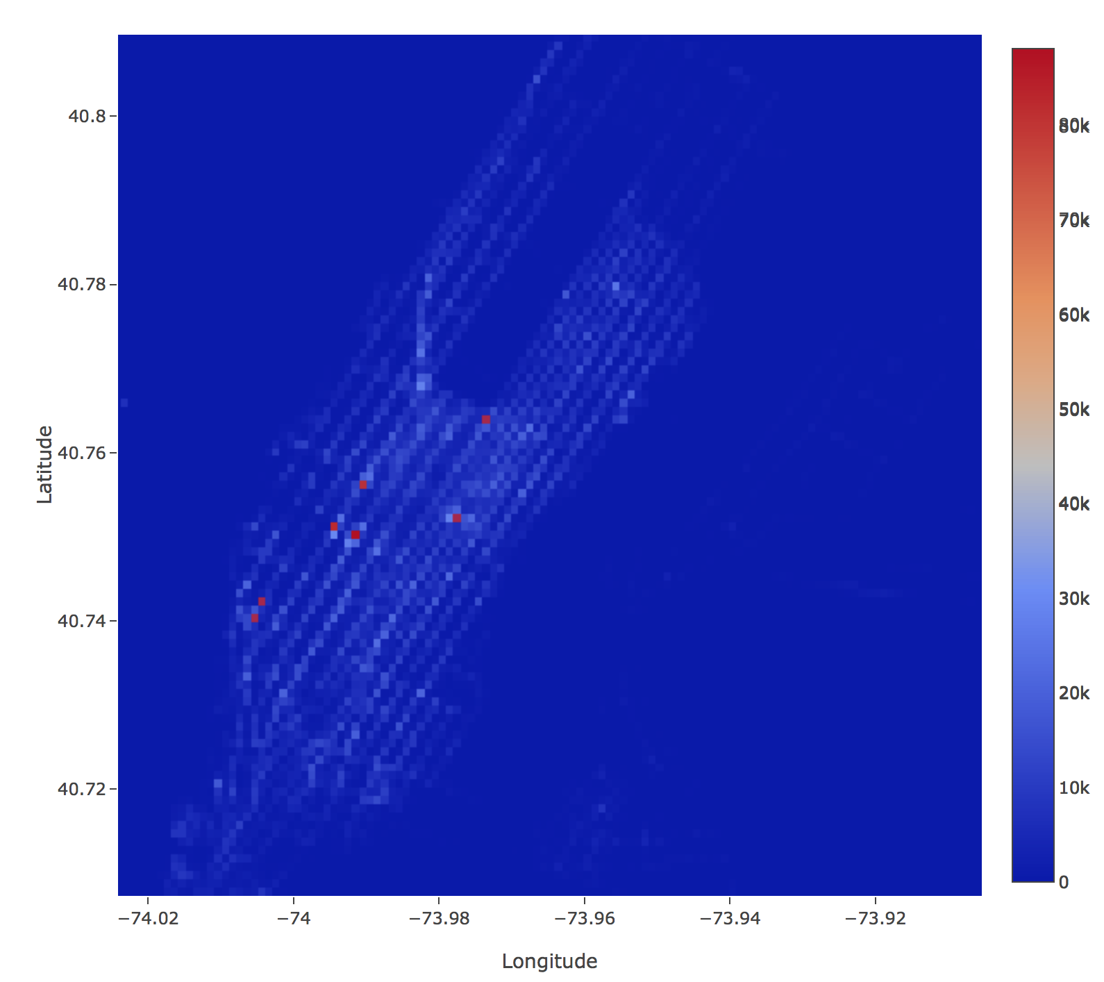
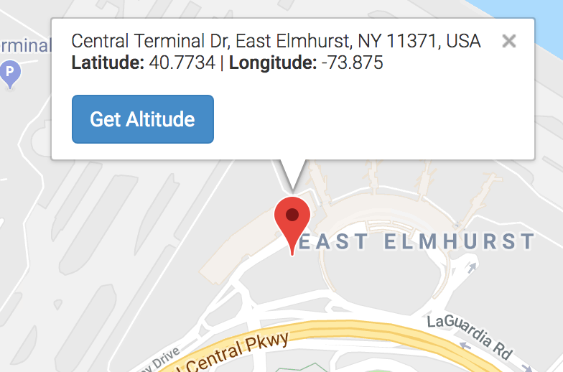
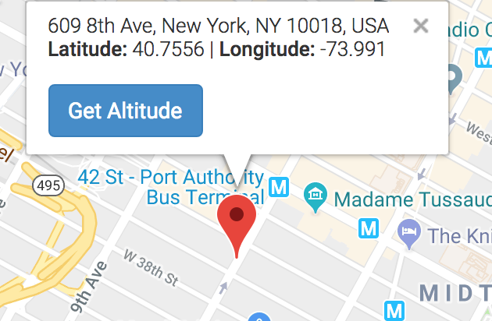
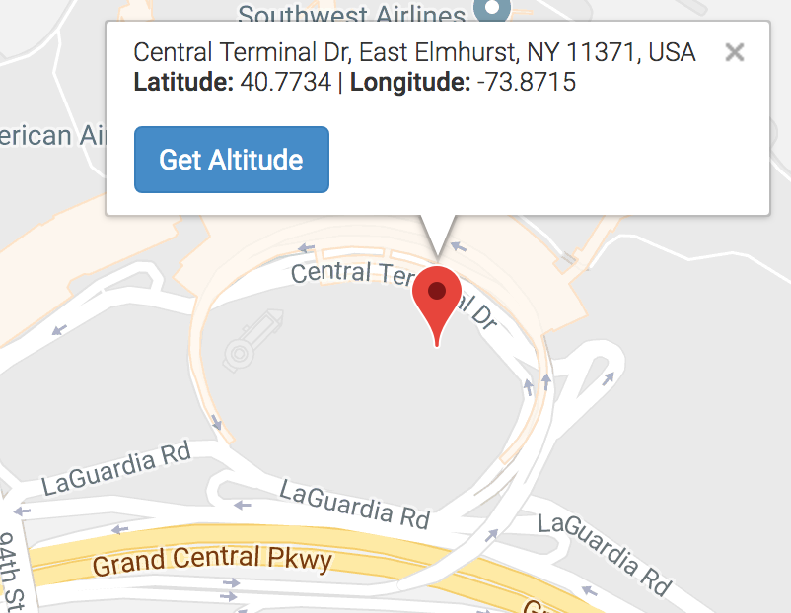
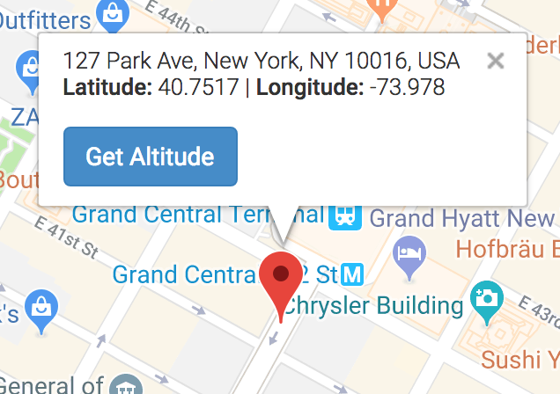
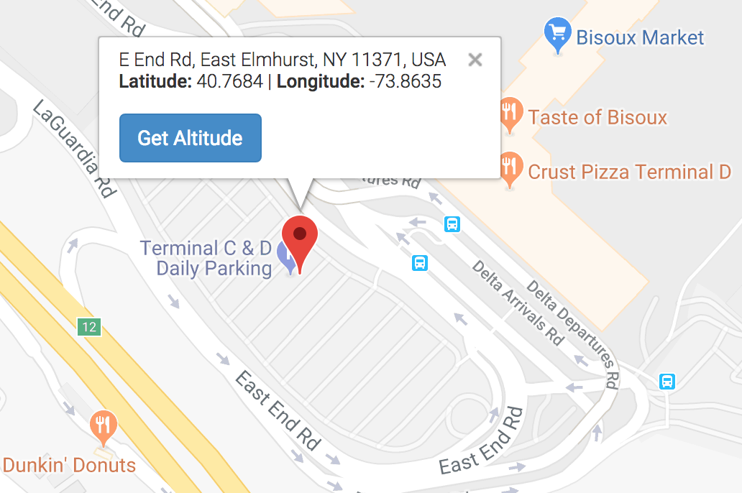
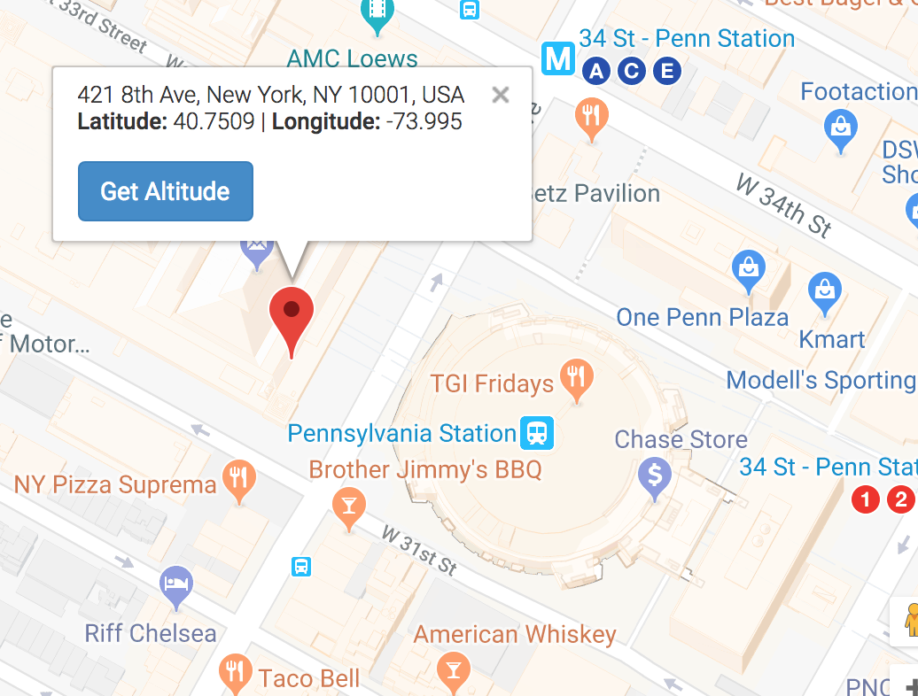
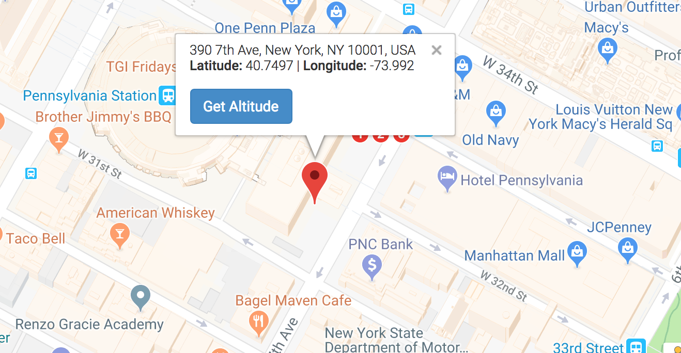
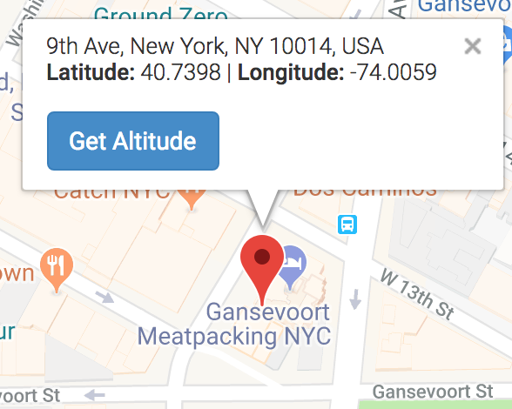
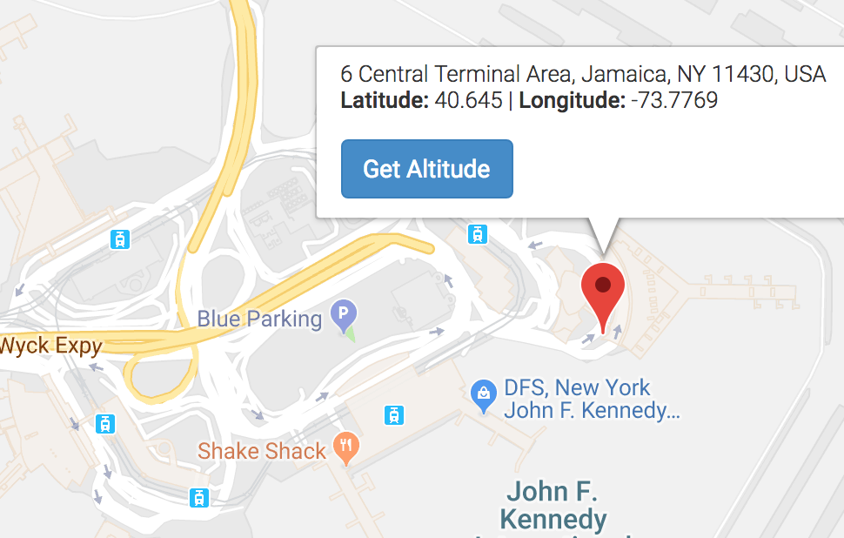
No. Trips Longitude Latitude Location
88214 -73.9920 40.7497 Pennsylvania station (E)
61200 -73.9950 40.7509 Pennsylvania station (W)
55889 -73.8635 40.7684 La Guardia Terminal C and D
52705 -73.8715 40.7734 La Guardia Terminal B
49319 -73.9910 40.7556 Port Authority Bus Terminal
46684 -73.8750 40.7734 La Guardia Terminal A
31765 -74.0059 40.7398 Meatpacking District
31526 -73.9741 40.7635 Trump Tower
30375 -73.9780 40.7517 Grand Central Station
29870 -74.0049 40.7418 Westville Chelsea
29804 -73.7769 40.6451 JFK

Slide 17
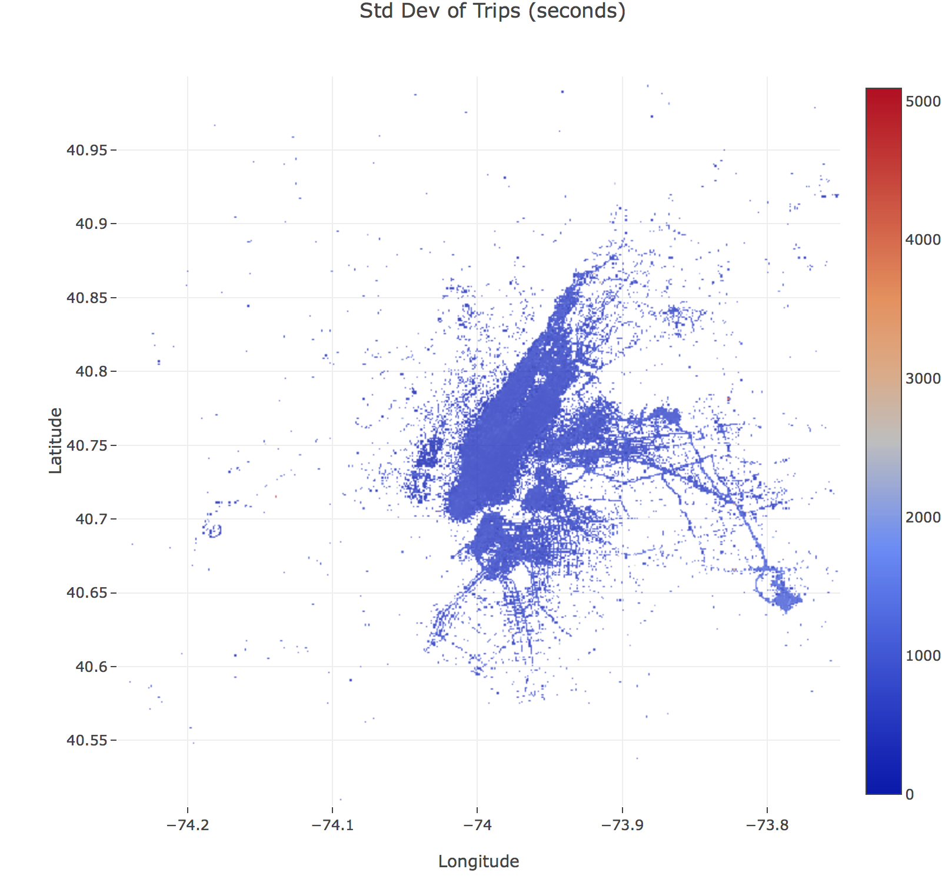
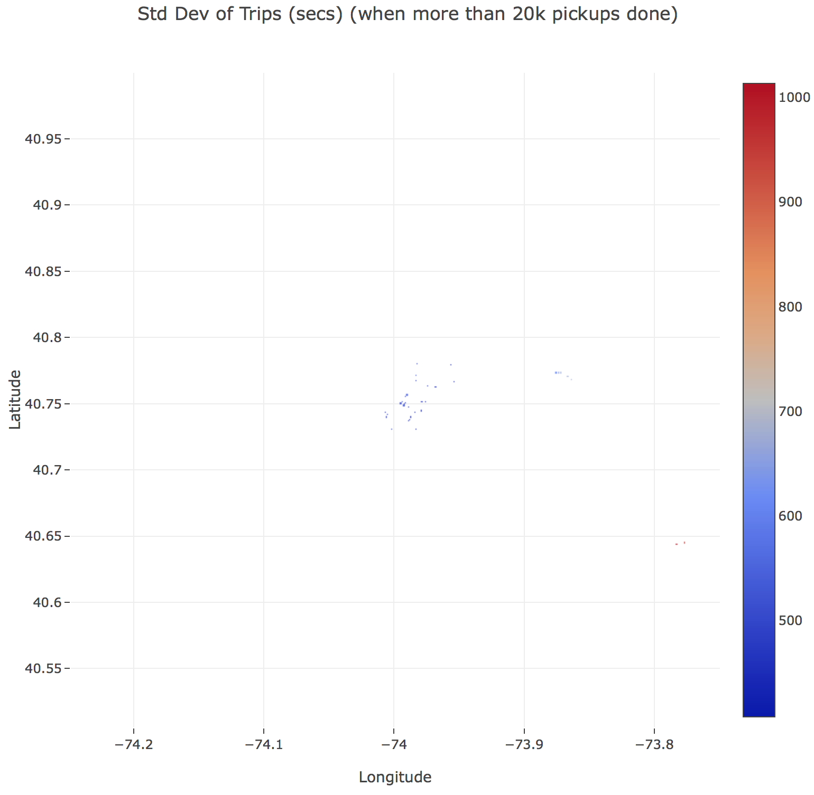
BQ h) Travel time variations
Standard deviation for each cell in the 500x500 grid of 100m x 100m resolution.
Lower plot only shows points if they are generated from more than 20,000 trips i.e. the busy locations.
Clustering seen at Midtown/Lower Manhattan, La Guardia and JFK.
One would expect uncertainty in the trip durations to occur when picking up passengers at airports and train/bus stations.

Slide 18
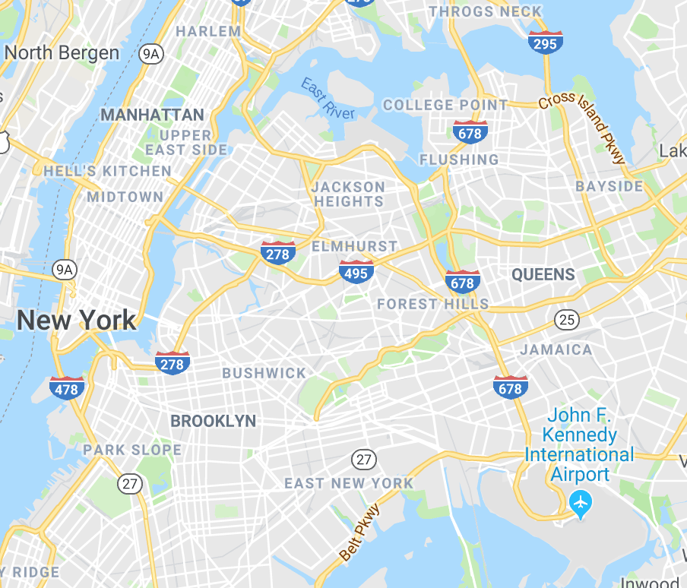
BQ h) Travel time variations
Time(s) Longitude Latitude Location
1013 -73.7829 40.6441 JFK
950 -73.7769 40.6451 JFK
678 -73.8635 40.7684 La Guardia Terminal C and D
675 -73.8665 40.7704 La Guardia Terminal C
660 -73.8715 40.7734 La Guardia Terminal B
645 -73.8735 40.7734 La Guardia Terminal B
614 -73.8755 40.7734 La Guardia Terminal A
540 -73.9900 40.7566 Port Authority Bus Terminal
527 -73.9830 40.7714 Broadway
512 -73.9930 40.7487 Pennsylvania station

Slide 19
BQ i) Fare consistency
Interprete as pickup locations with minimum std deviation in fares.
Use same 500x500 grid as previously. Focus on cells with more than 20,000 trips.
SD(Fare) Longitude Latitude Location
5.75 -73.9561 40.7792 E86 and Lexington
6.23 -73.9680 40.7625 Bloomingdales
6.34 -73.9869 40.7398 23rd Street Station
6.37 -73.9541 40.7664 E71 and York
6.42 -73.9909 40.7506 Penn Station (7Ave)
6.71 -73.9879 40.7378 E19 and Park S
6.71 -74.0069 40.7437
6.84 -73.9830 40.7309
6.87 -73.9919 40.7496
6.98 -73.9830 40.7674
7.00 -73.9889 40.7368

Slide 20
BQ i) Fare consistency
Also look at ratio of mean(fare) / std(fare)
Maximising the ratio picks larger fares with smaller std deviations.
Ratio Longitude Latitude Location
3.68 -73.8635 40.7684 La Guardia C and D
3.61 -73.8754 40.7733 La Guardia A
3.39 -73.8665 40.7704 La Guardia C
3.24 -73.8715 40.7733 La Guardia B
3.23 -73.7769 40.6451 JFK T5
3.18 -73.8735 40.7733 La Guardia B
2.95 -73.7829 40.6441 JFK T4
1.77 -73.9541 40.7664 E71st and York
1.67 -73.9681 40.7625 Bloomingdales
1.64 -73.9949 40.7506 Pennsylvania station
Interesting that the airports and Penn station are selected.
Shows impact of larger fares on the ratio.
Expect JFK to be consistent given set fare of $52 to Manhattan.

Slide 21
Open questions
See file:
a) taxi model central tendency v1.pynb
b) taxi model v1.pynb
c) taxi model maximise earnings v2.pynb
d) taxi model minimise worktime v1.pynb
e) taxi model 10taxis v1.pynb

Slide 22
OQ a) Central Tendency
Central tendency is a central value or typical value used to represent a distribution.
Mean: sum of all values divided by number of values.
Median: the middle value of the ordered values.
Mode: the most frequent value in the data.
Use median or mode for ordinal data (categories which have an order but are not measured absolutely).
Use mode for nominal data (qualitative categories with no intrinsic ordering).
Use median for strongly skewed data.
Use mean for continuous and symmetrical distributions.
Median usually preferred when mean distorted by outliers.
https://en.wikipedia.org/wiki/Central_tendency
https://statistics.laerd.com/statistical-guides/types-of-variable.php
https://statistics.laerd.com/statistical-guides/measures-central-tendency-mean-mode-median-faqs.php
https://statistics.laerd.com/statistical-guides/measures-central-tendency-mean-mode-median.php
http://www.abs.gov.au/websitedbs/a3121120.nsf/home/statistical+language+-+measures+of+central+tendency

Slide 23
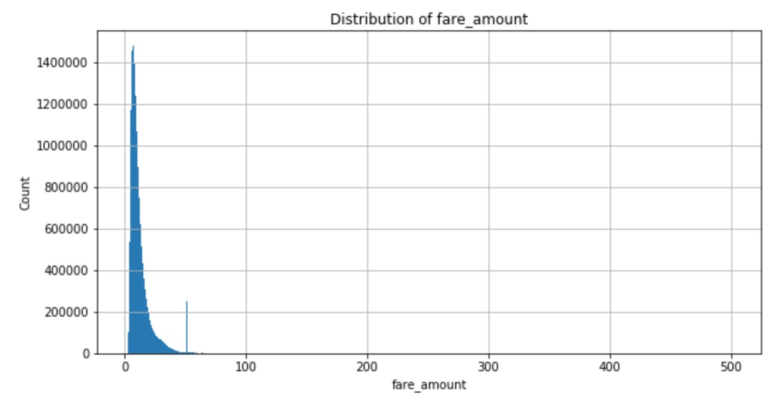
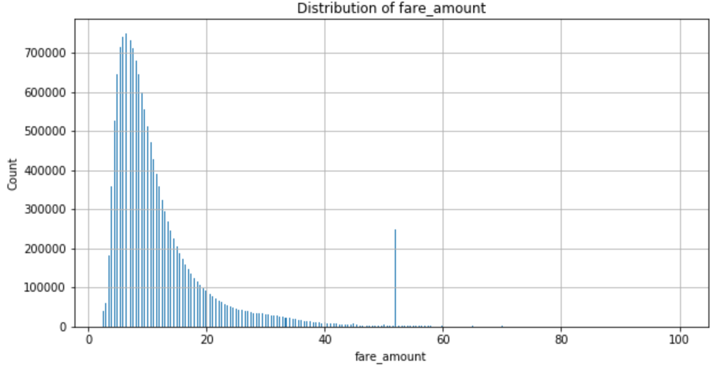










OQ a) Central Tendency
fare_amount: continuous, non-symmetric, large skew: use median
trip_time: non-symmetric, large skew
should be continuous but can see spikes
use median
tip_amount: non-symmetric, large skew
bimodal with large zero spike (cash payments?)
use median of distribution excluding zeros

Slide 24

OQ b) build model to predict fare
Choose to use linear regression model because:
Easy to analyse
Quick to train
Sufficient
Use 67% of data (9.9mio rows) for training and 33% (4.9mio) for test. Choose to randomly select from the whole dataset rather than any cutoff based on time of month.
Include seconds_from_midnight (linear, continuous proxy for time of day) and L1distance (NYC is gridlike). Plus pickup and dropoff latitude and longitude.
Question as to whether the dropoff information is available at start of trip? But maybe it is (just as for Uber).
Get R2=0.8 and MSE=18.5
There are a few cases where the prediction is close to zero but the actual fare is much larger. Investigation shows that the pickup and dropoff points are the same but the time taken and distance travelled is appreciable. Assume these trips are rounds trips back to the start.
Then try normalising (zero mean, 1 stddev) the inputs. This has minimal impact (due to the maths of the linear model). Get R2=0.8 and MSE=18.5
Easy to see that the L1distance has the biggest coefficient with all others small. (0.28, 0.12, 0.61, 0.26, 0.002, 8.5)
Trying different random number seeds has minimal impact.
Using only a single feature of L1distance has minimal impact. Get R2=0.79 and MSE=18.9
Adding a second feature of seconds_from_midnight has minimal impact (and very small coefficent).
Using a single feature of L2distance improves R2 by 2% and MSE by 2. Get R2=0.82 and MSE=16.8
Using all the original features plus L1distance and L2distance has minimal impact.
Conclusion: we can use L2distance as a single feature for the linear regression model. Not too surprising, given fare is a function of distance.

Slide 25



OQ b) build model to predict tip
Choose to use linear model for same reasons as previous slide, and some consistency.
Include seconds_from_midnight, L1distance and L2distance. Plus pickup and dropoff latitude and longitude.
Get R2=0.25 and MSE=3.25
Not good, so let’s look for some structure by plotting features vs tip. Not much there.
See horizontal rows at multiples of banknote values (20, 40, 50, 60, 100, 200).
See lots of zero tips. Suspect these are cash tips which don’t go through the system.
A bit of structure when we compare fare vs tip
Some tips scale as percentage of fare
Some multiples of $50 tips
Some multiples of $50 fares (assume prearranged)
Adding fare as a feature (even if not known beforehand) gives minor improvement of R2=0.28 and MSE=3.09
Removing features (e.g. fare, pickup and dropoff info) also has minimal impact.

Slide 26



OQ c) taxi owner, maximise earnings
There are 13,296 taxis and 32,961 drivers.
Generally 2 drivers per taxi although a fair number have 3.
A few taxis have around 50 drivers: a lot of sharing!
Most drivers always use the same taxi.
One driver is using 161 taxis in a month: dubious, maybe replicated medallion?
Ways to maximise earnings:
Use car continuously
Get best drivers
Go to best pickup locations
Lets learn from the best taxi i.e. with biggest monthly income.
Meet taxi: '19E063791B0DF5A558B8488180DDAB67’
It has two drivers. They drive it continuously.
Generated income of $26,870 from 2,093 trips.
Stands out compared to other taxis with around $24,000 income.
To understand how they generate income, let’s break down their pickup strategy.

Slide 27




OQ c) taxi owner, maximise earnings
Across the month, many pickups in Manhattan and fair number at La Guardia and JFK.
Analysis by hour of the day shows:
Always doing pickups in Midtown/Lower Manhattan area
Very few pickups at 3am and 4am. A few La Guardia pickups at 4am.
5am has many pickups, people starting to go to work.
JFK: do pickups at 8am and at 6-7pm.
La Guardia: noon and a few at 4am or 5pm.
Rest of time stay around Midtown/Lower Manhattan area.
Cluster around Park Ave / E 61st at 3pm.

Slide 28





OQ d) taxi driver, minimise worktime
There are 32,961 drivers. Their daily income is normally distributed with a mean and median of roughly $282.
So let’s take the average wage as $282.
The distribution of income per trip is skewed. The median is $3-$4 below the mean.
We will use the median to represent the ‘average’ value.
As a function of time, the median income per trip varies between $9.40 and $12.50.
The distribution of trips per hour is also skewed. We will represent it by the median values.
As a function of time, the median trips per hour varies between 0.5 to 2.4.
The expected income per hour plot shows how the bigger incomes occur during the evening.
Assuming the driver wants to work consecutive hours, working from 11am to midnight generates $288.

Slide 29
OQ e) taxi owner, maximise 10 taxis
If we have an optimal strategy for one taxi, then this could be replicated for 10 taxis.
The randomness of any one trip means that the taxis will not often be at exactly the same location.
But maybe we can view the earnings within a Markowitz mean-variance portfolio theory framework!
There are 13,296 taxis. We can calculate their daily income for each day of the month.
This gives 13,296 time series, each of 30 points. We can calculate the mean, std dev and correlations for these time series.
This enables us to view each taxi as an asset with a return (mean) and a risk (std dev).
We now want to select a portfolio of 10 taxis such that the portfolio mean is maximised and the portfolio std dev is minimised.
Mathematically, we can set up a Lagrangian function to optimise over and then solve it.
However in this context with discrete constraints, it is an NP hard problem.
Simplification: Let’s get the 20 biggest return taxis. Then calculate the correlations. Check for negative ones.
Then choose the best 10 taxis (which have lots of negative correlations).
Calculate the mean and std dev of this new portfolio of taxis.

Slide 30


OQ e) taxi owner, maximise 10 taxis
The mean and stddev for daily income of some taxis is shown here. It has been sorted by mean.
The first row has a huge stddev. Investigation showed that they had income of 10,790 on 17 April. Decided to remove this taxi.
Investigation also showed that two of the other top 20 taxis had NaN indicating that no income on various days. Decided to remove them too.
Then chose taxis with many negative correlations from the correlation matrix shown. Note that the -1 in the top, left cell has been placed there artificially to get the full range of colors on the heatmap.

Slide 31


OQ e) taxi owner, maximise 10 taxis
The mean and stddev for daily income of the selected 10 taxis is shown here.
The new correlation matrix for the ten selected taxis is shown. Note that the -1 in the top, left cell has been placed there artificially to get the full range of colors on the heatmap.
This results in a portfolio mean of $810.97 with portfolio std dev of $40.91.
Note that this std dev is significantly less than the std dev of any of the individual taxis.

Slide 32
Thank you for taking the time to read this analysis!

